Slide 1
Adult Education Officers Association Annual Conference 2024
Further Education and Training Meets Adult Education:
Narrating Experience (Psychology) with a Sociological Imagination
Ted Fleming
Emeritus Professor, Maynooth University
Adjunct Associate Professor
at Teachers College Columbia University, New York
Adult Education Officers Association Conference
LWETB, Athlone, November 19, 2024.
MAYNOOTH
UNIVERSITY

Slide 2
I am telling this for two reasons:
That was a time when the only citizens in Ireland who did not know where to go for education were adults.
Children went to NS, teens went to Secondary Schools, and university and new RTCs.
Only recently, are there any places known as Adult Education Centres & FET Colleges.
These autobiographicals are the foundation on which all our thinking is based. Hannah Arendt (2018, p. 200) held that rigorous thinking should be grounded in lived experience:
…no matter how abstract our theories may sound or how consistent our arguments may appear, there are incidents and stories behind them which at least for ourselves, contain in a nutshell the full meaning of whatever we have to say. Thought itself…arises out of the actuality of incidents, and incidents of lived experience must remain its guideposts by which thinking soars, or into the depths to which it descends.

Slide 3
Google to Athlone

Slide 6
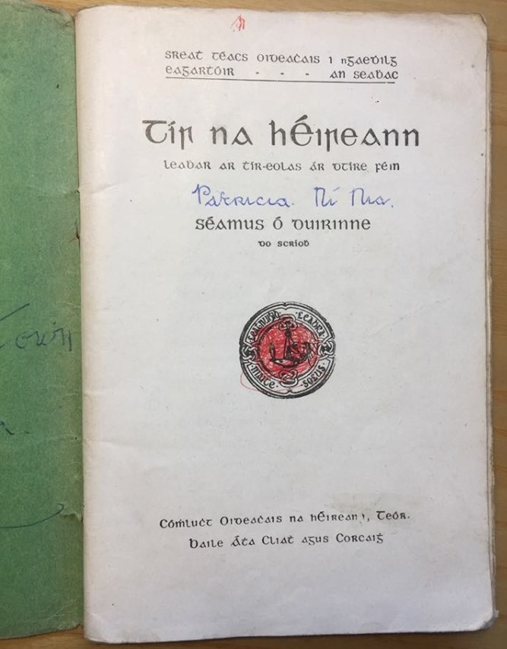

Slide 7
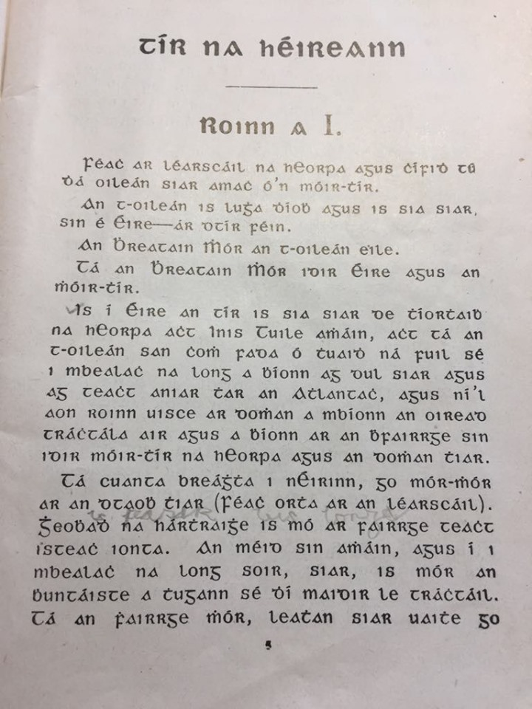

Slide 8
How many people could quote the Easter Proclamation of 1916? It says:
Irishmen and Irishwomen…
In the name of God and of the dead generations from which she receives her old tradition of nationhood, Ireland, through us, summons her children to her flag and strikes for her freedom. We declare the right of the people of Ireland to the ownership of Ireland…
The Republic guarantees religious and civil liberty, equal rights and equal opportunities to all its citizens, and declares its resolve to pursue the happiness and prosperity of the whole nation and of all its parts, cherishing all the children of the nation equally, ….

Slide 9
All adults
have a right
to learn
all that it is possible to learn

Slide 10
We have no idea in Ireland what literacy is required in order to lift us above an economy to become a Republic, a democracy, a society that works as hard for human rights and worker’s rights and freedom as it does for the economy. Who we are and who we will be is a task that requires, as it always did, literate and critical citizens. We will not Google our way to this.
At least the school textbooks of the 1950 had a version of Irish identity. We hardly noticed its hidden curriculum and we can be critical of that too. The current (not so) hidden curriculum is to draw a line around knowledge and literacies that are functional and useful for an economy, and in its focus on training, it ignores education. In the context of lifelong learning and a national jobs strategy it might be a really worthwhile goal to include broader social learning goals. As a result a competitive economy may be a healthy, fulfilling and equal society and it may indeed contribute to becoming “ár dtír féin” – our own country!

Slide 11
What images would you use to express further and adult education?

Slide 12
Mise Éire: Sine mé ná an Chailleach Bhéarra
Mór mo ghlóir: Mé a rug Cú Chulainn cróga.
Mór mo náir: Mo chlann féin a dhíol a máthair.
Mór mo phian: Bithnaimhde do mo shíorchiapadh.
Mór mo bhrón: D'éag an dream inar chuireas dóchas.
Mise Éire: Uaigní mé ná an Chailleach Bhéarra.

Slide 13
Paulo Freire on Neoliberalism
Speaks about the need for unemployment, for poverty, for inequality. I feel it is our duty to fight against such fatalistic mechanical forms of comprehending history…if we allow ourselves to fall for the trickery of neoliberal economic discourses, which affirm realities of homelessness and poverty as inevitable, then opposition for change becomes invisible, and our role in fostering change becomes absent. (Freire, 2007, p. 4)p. 4)

Slide 14
Picasso
You have to wake people up. To revolutionise their way of identifying things. You’ve got to create images they won’t accept…Force them to understand that they’re living in a pretty queer world. A world that is not reassuring. A world that’s not what they think it is. (Malraux, 1974, p. 110)

Slide 15
The ability to argue for an alternative or a more inclusive response than the functional one proposed by Government is a most important ability. The main supporting idea I want to emphasise is that ‘education’ remains in many titles Education and Training Boards, etc
So how can we hold the education brief? Or more critically: What is education?
How can we argue FOR EDUCATION (that is beyond training)?

Slide 16
What is Neoliberalism?
A theory of political economic practices that proposes that human wellbeing can best be advanced by liberating individual entrepreneurial freedoms and skills within an institutional framework characterized by strong private property rights, free markets and free trade. (Harvey)
neoliberalism is a political economic paradigm that refers to the policies and processes whereby a small number of private interests are permitted to control as much as possible of social life in order to maximize their personal profits. (McChesney)
The neo-liberal economic doctrine proclaiming the superiority of free markets over public ownership, or even public regulation of private economic activities, has become the conventional wisdom, not only among conservatives but among the progressives. (Aronowitz)

Slide 17
Ireland in the past 25 years developed quickly and is, even following the demise of the Celtic tiger, a model of success for many countries.
The idea was widely believed that when everybody is working and the benefits are distributed by government tax policies that a fair society will be created and sustained.
The idea that everybody benefitted from the Celtic Tiger and since then is a myth.
Having looked forward for generations to having work, the arrival of almost full-employment disappointed. Work was not sufficient to cure all ills. Inequalities of social class continued, and housing, education, and health compared poorly in comparison with other developed countries, e.g., in EU and OECD.
The accumulation of wealth by a few was a major scandal showing how work is not necessarily the source of more equality, or better housing, or better health care, or any other measure of equality. Ireland in 2000 was the second most unequal society in the EU. With 15.3% living in poverty, only the US, among Western countries was worse with 15.8% in poverty (Paul Cullen, 2002).

Slide 18
2022 Census
Total population in 2024 = 5,200,000
Census 2022: 2.3 million working. In 1986 it was 1.1 millioion
32% of workers work from home.
CSO in 2024: Total number of students in Ireland in 1986 = 245,000
Total number of students in Ireland in 2024 = 460,000
CSO (2017): Number in 2016 who left school at or below 15 = 388,000
Number in 2022 who left school at or below 15 = 269,000 [from larger pop]
In education beyond 25 years of age in 2011 = 190,000
` in 2022 = 374,000
Number of adults with only primary in 2011 = 414,000
in 2022 = 251,000
Emigration in 2023: Number emigrated = 64,000. Number of Irish citizens emigrated 30,500
Immigration in 2023 = 141,000 [ non-UK + non-EU + non-Irish = 81,000] Ukraine = 42,000
Total population over 65 in 2017 = 153,000
in 2022 = 806,000

Slide 19
A major task for educators is to read and study and continue to read and study. This is an important element of one’s survival skills in this world of rapid change and reconstruction and destruction. You will need to keep your mind honed on the agenda and keep in touch with how others perceive what is happening. Continuous professional development understates the task.

Slide 20
What is TL? Slide 1
Transformative learning is according to Mezirow (1985, p. 22) the;
…the process of becoming critically aware of how and why the structure of
our psychocultural assumptions has come to constrain the way in which we
perceive our world, of reconstituting that structure in a way that allows us to
be more inclusive and discriminating in our integrating of experience and to
act on these new understandings...
For Mezirow (2000: 7–8) transformative learning is:
the process by which we transform our taken-for-granted frames of reference
(meaning perspectives, habits of mind, mind-sets) to make them more
inclusive, discriminating, open, emotionally capable of change, and reflective
so that they may generate beliefs and opinions that will prove more true or
justified to guide action.

Slide 21
Slide 2
TL is a critical process of
becoming critically aware of how and why the structure of our psychocultural
assumptions has come to constrain the way in which we perceive our world, of
reconstituting that structure in a way that allows us to be more inclusive and
discriminating in our integrating of experience and to act on these new
understandings.

Slide 22
When students arrive they bring with them their hopes, despair, expectations, knowledge, which they got by living. Freire puts it this way:
They do not arrive empty. They arrive full of things....they bring with them their knowledge at the level of common sense, and they have the right to go beyond this level of knowledge....This is a right that the people have, and I call it the right to know better what they already know. Knowing better means precisely going beyond the common sense in order to discover the reason for the facts.

Slide 23
The First Idea: Recognition is Transformative
Recognition is a vital human need.
We are always interconnected, “the self is always plural” (Brecht).
“Once upon a time….” ….in order to survive each one needs an adult who will feed, nurture, care for, and provide a safe place from which to begin our journey of exploring the world.
In these moments (experiences) our brain is wired and fired with an internal map of how the world of interpersonal relationships operates.
This is how we become somebody (an identity).
The vital ingredient is recognition…..an adult recognises the infant as….

Slide 24
The Struggle for Recognition
Without recognition life will not flourish, develop, grow.
Bowlby, Winnicott, etc.
The struggle for recognition is:
Not just confined to infancy
Emerges to be achieved (recognition that is) again and again
In relationships in family and interpersonally
In laws, recognised as citizen, as having rights, etc
In work and in community where solidarity and care are exercised
This developmental journey toward identity is LIFELONG
A key moment in the thinking of the 3rd generation of critical theorists. [many implications....].

Slide 25
How important is the struggle for recognition?
Think of the denial of recognition
To children, in families, in relationships
In laws
At work
According to Axel Honneth ‘misrecognition is the pathology of these capitalist times’.
Misrecognition is profoundly destructive because?
Not recognising is not only social and political &....but personal
The struggle for recognition is the motivation for social change: the struggle for recognition bridges methodological gap between the traditional polarities/dualisms of structure and agency.
If recent thinking sees that the personal is political; we can now (in dialectical moments) see the political is personal.

Slide 26
The First Idea
The political is personal;
The social is personal;
What institutions do is experienced as personal.

Slide 27
The Second Idea
The pursuit of recognition is lifelong – the struggle is lifelong and involves a great deal of learning…. This is lifelong learning!
Recognition is not just (good) for infants. Recognitions happen in three areas:
Interpersonal relationships in family and among close friends;
In the legal – policy world
In the world of work

Slide 28
Axel Honneth
The key insight for me is the huge amount of research that shows that:
The respect and recognition received by a child is developmental;
It is this recognition/respect that characterizes all relationships;
Adults too throughout our lives seek out, need and treasure this recognition;
This is developmental for adults too;
The pursuit of attachment and respect is developmental and lifelong.

Slide 29
Is there more? There is always more.
We arrive in the world pre-programmed for attachment. We arrive in the world pre-programmed for recognition. Recognition is the precondition for survival, for identity formation, for those who work in the intimate spheres of family education, and work, and political spheres. Recognition is foundational for democracy.

Slide 30
How does all this link into FE?
Research indicates that students look to education as a remedy for the multiple misrecognitions of schooling, of society and of other social experiences.
It was just my own will power you come across people who, no matter how stupid you are or how unaware you are of your ability and they find space for you...and it’s people in education too...They were saying I had what it takes [to study at university].
They were seeing something…I think my reaction to the books they gave me…I thought they were the mad ones. They could see me starting college, they told me this since. That’s what they said anyway. You come across people who, no matter how stupid or unaware you are of your ability, they can see something and they point it out.
Are they justified in doing this? Is this what FE is about.
AND how should this impact on teaching in FE?

Slide 31
A Charter for Learners’ Rights
Understand what education is and how it is more than skills;
Learn to argue that training alone is not education;
Adults have a right to learn all that it is possible to learn;
In ways and in situations that are conducive to their ways of learning;
Democracy, equality, care, justice, fairness require learning – they are not skills;
That education is a pre-requisite for a democracy, for a republic;
That we can measure the benefits of all learning;
That many social problems can be best understood and actions agreed through education (the environmental disaster is really only capable of being addressed through learning/education);
Government has a responsibility to support civil society;
Adult education embraces the requirement to be accountable;
Adult education is a sound investment and be properly funded.

Slide 32
A Charter (contd.)
In a gendered world adult education must teach for non-violent relationships.
Teach how to care – young children often learn this with animals and dolls.
Teach against bullying and other violent activities. Teach how to deal with bullying.
Focus on justice, injustices, teach how to feel injustice and discuss.
Teach that there are always multiple realities, multiple and varied ways of seeing the world.
Encouraging voice and agency.
Teaching how to create community.
How to deal with fake news and other modern internet and social media issues.
Teach values like equality, justice, diversity, truth, caring and the great joy of solidarity.
Teach how to take action against injustice and actively support of social change.
Apply all of these in whatever discipline one is involved in, e.g. science, engineering, geography, history, etc.
Learn how to discuss respectfully even in the midst of political fights whether major or minor.
Make each workplace a place of respect, and equality.

Slide 33
Irish Literature as a source of insight and ideas about learning
And so when I cast my mind back to the summer of 1936 different kinds of memories offer themselves to me. But there is one memory of that Lughnasa time that visits me most often; and what fascinates me about that memory is that it owes nothing to fact. In that memory atmosphere is more real than incident and everything is simultaneously actual and illusory…And what is so strange about that memory is that everybody seems to be floating on those sweet sounds, moving rhythmically, langourously, in complete isolation; responding more to the mood of the music than to its beat. When I remember it I think of it as dancing. (Friel, 1990, pp. 55-56)

Slide 39
Adverse Childhood Experience Study
What’s YOUR ACE Score?
1. Did a parent or other adult in the household often or very often... Swear at you, insult you, put you down, or humiliate you? or Act in a way that made you afraid that you might be physically hurt?
2. Did a parent or other adult in the household often or very often... Push, grab, slap, or throw something at you? or Ever hit you so hard that you had marks or were injured?
3. Did an adult or person at least 5 years older than you ever...Touch or fondle you or have you touch their body in a sexual way? or Attempt or actually have oral, anal, or vaginal intercourse with you?
4. Did you often or very often feel that ... No one in your family loved you or thought you were important or special? or Your family didn’t look out for each other, feel close to each other, or support each other?
5. Did you often or very often feel that ... You didn’t have enough to eat, had to wear dirty clothes, and had no one to protect you? or Your parents were too drunk or high to take care of you or take you to the doctor if you needed it?

Slide 40
6. Were your parents ever separated or divorced?
7. Was your mother or stepmother: Often or very often pushed, grabbed, slapped, or had something thrown at her? or Sometimes, often, or very often kicked, bitten, hit with a fist, or hit with something hard? or Ever repeatedly hit at least a few minutes or threatened with a gun or knife?
8. Did you live with anyone who was a problem drinker or alcoholic or who used street drugs?
9. Was a household member depressed or mentally ill, or did a household member attempt suicide?
10. Did a household member go to prison?
For further information see: http://www.acestudy.org/

Slide 41
What is a democracy?
Democracy is a way of living together in which all members have equal power to discuss and bring into public debate, not influenced by vested interests (those with money and power), all matters of concern to citizens;
To make decisions and suggestions that can be taken into public policy and legislative arenas for implementation;
It is a way of having conversations that hold every power holding person and institution to account, open to critical questioning and searching for evidence to support arguments.
It creates a way of living together in which all are treated with equality.
Democracy is a learning and developmental project.
A very good argument can be made to state that this is also the kind of discussion that defines an adult learning community.

Slide 42
A charter for a Democracy that Learns
Teaching how to hold on to the imagination so we can picture how it is for others and how it ought to be.
Making opportunities for exercising creativity through art, dance, literature, theatre and all works of creativity and play. Assisting young people and adults with the difficult tasks of making decisions about what to do with their lives.
Creating the possibilities of empathy and valuing one’s own feelings and of others so that we can communicate with civility.
Learn to recognize our own uniqueness and that of others; Respond to the need for all to be recognized.
How to debate, discuss, argue, defend points of view, opinions and values in a community of equal respect in solidarity.
Teach respect for others, especially those we perceive to be different – refugees, youth, other religions, travellers, disabilities, gender, respect by men for women. Men must move over (slightly or a great deal to make room for our sisters on public platforms and in all social areas).
To see the world as connected.

Slide 43
Education/learner Proof courses….define learning is a most holistic way, argue for it, include it everywhere, stick to your convictions, convince. Argue how education requires ……Argue with cogent and quotable references to Dewey, Freire, and any others you know

Slide 44
nobody ever asked me what I wanted for Christmas. Had any adult with the power to fulfil my desires taken me seriously and asked me what I wanted, they would have known that I did not want to have anything to own, or to possess any object. I wanted to feel something on Christmas day. The real question would have been ‘Dear Claudia, what experience would you like on Christmas?’ I could have spoken up, ‘I wanted to sit on a low stool in Big Mama’s kitchen with my lap full of lilacs and listen to Big Papa play his violin for me alone.’ The lowness of the stool made for my body, the security and warmth of Big Mama’s kitchen, the smell of the lilacs, the sound of music, and, since it would be good to have all of my senses engaged, the taste of peach, perhaps

